Slide 1

Elementary Education
Induction day
August 19, 2025

Slide 2


Slide 3
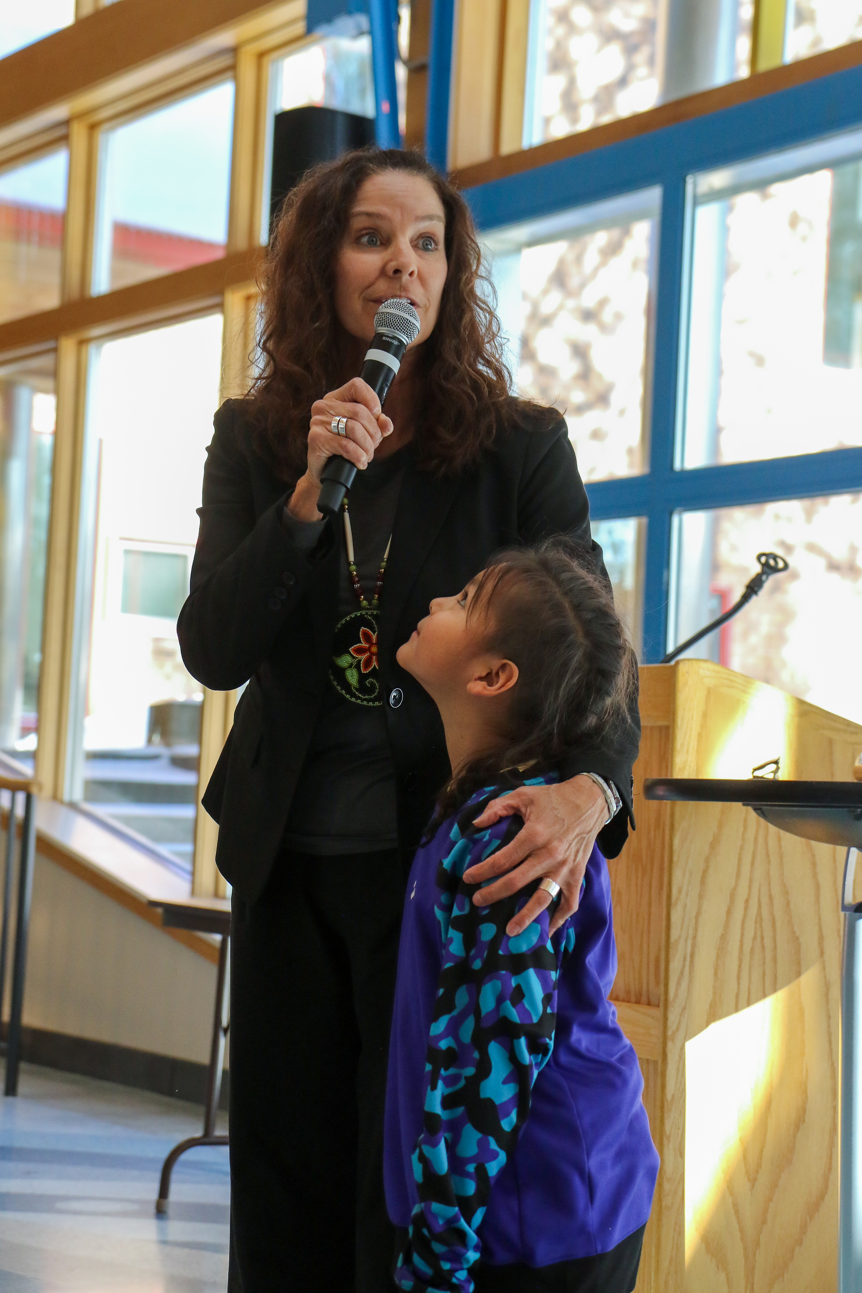
Welcome/Boozhoo
President Anita Hanson

Slide 4
Agenda
Opening Prayer-Lyz Jaakola
Welcome: President Anita Hanson
Introductions of the Elementary Education Team
Sara Montgomery, Jessica Thompson, Tara Graves, Dawn Quigley
What is the Induction Ceremony?
Elementary Education Vision and Mission
Program Requirements
Higher Expectations at the Jr and Sr Years
Student Teaching
Field Experience
Opportunities (both financial and classroom)
Pinning
Refreshments

Slide 5
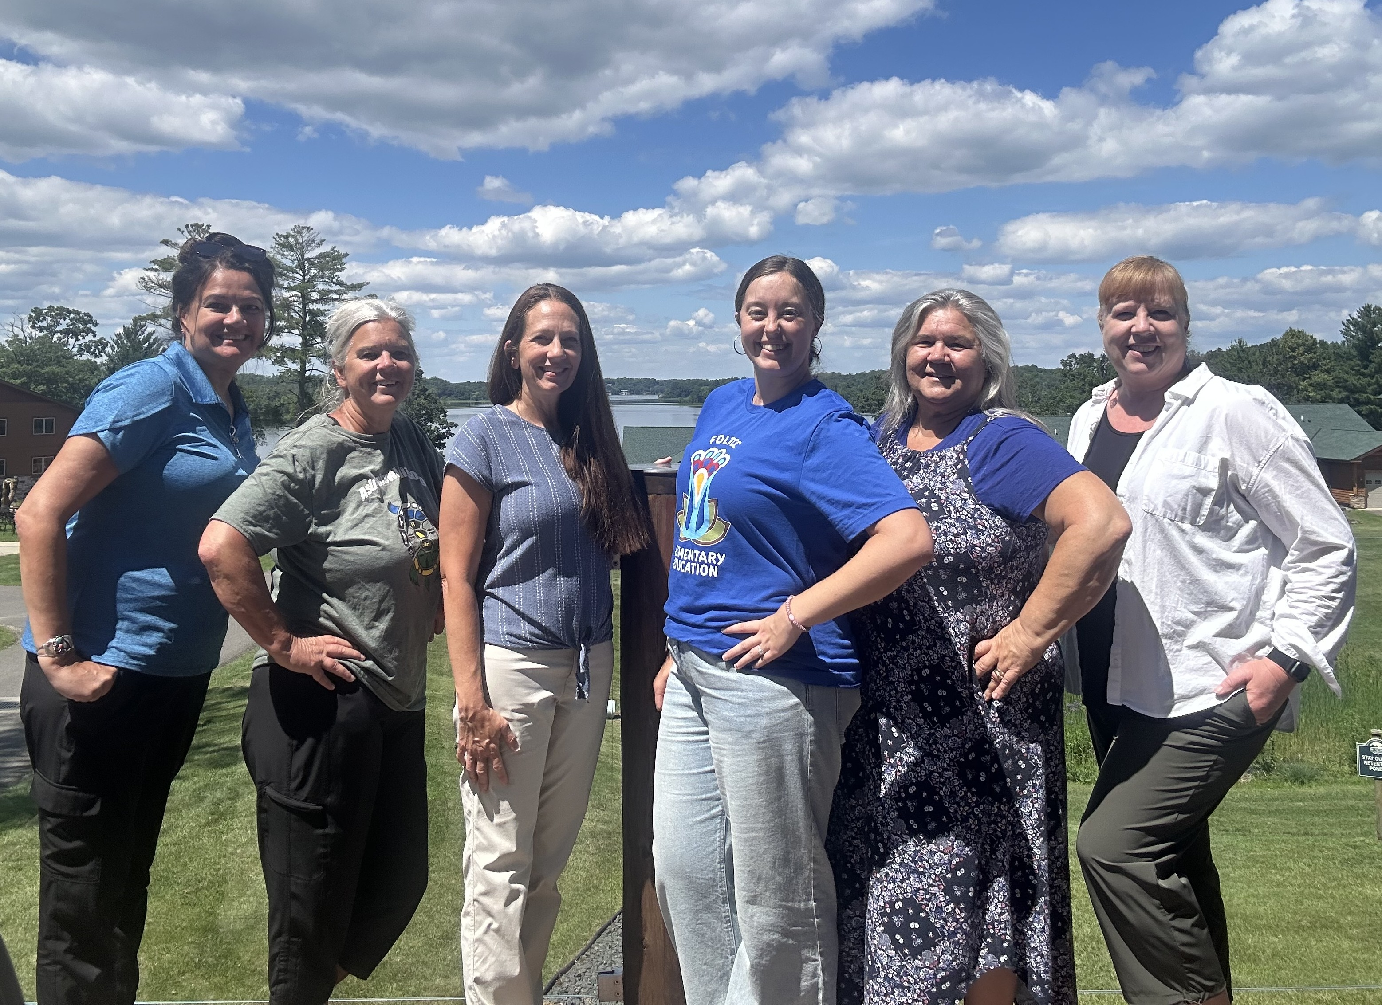
FDLTCC Elementary Education Team
Sara Montgomery, Dean of Education
Dr. Dawn Quigley, Elementary Education Faculty, Advisor, Student Teacher Supervisor
Tara Graves, Education Facilitator, Advisor, Field experience Coor.
Jessica Thompson, Elementary Education Program Coordinator, faculty
Education and FDLTCC Faculty

Slide 6
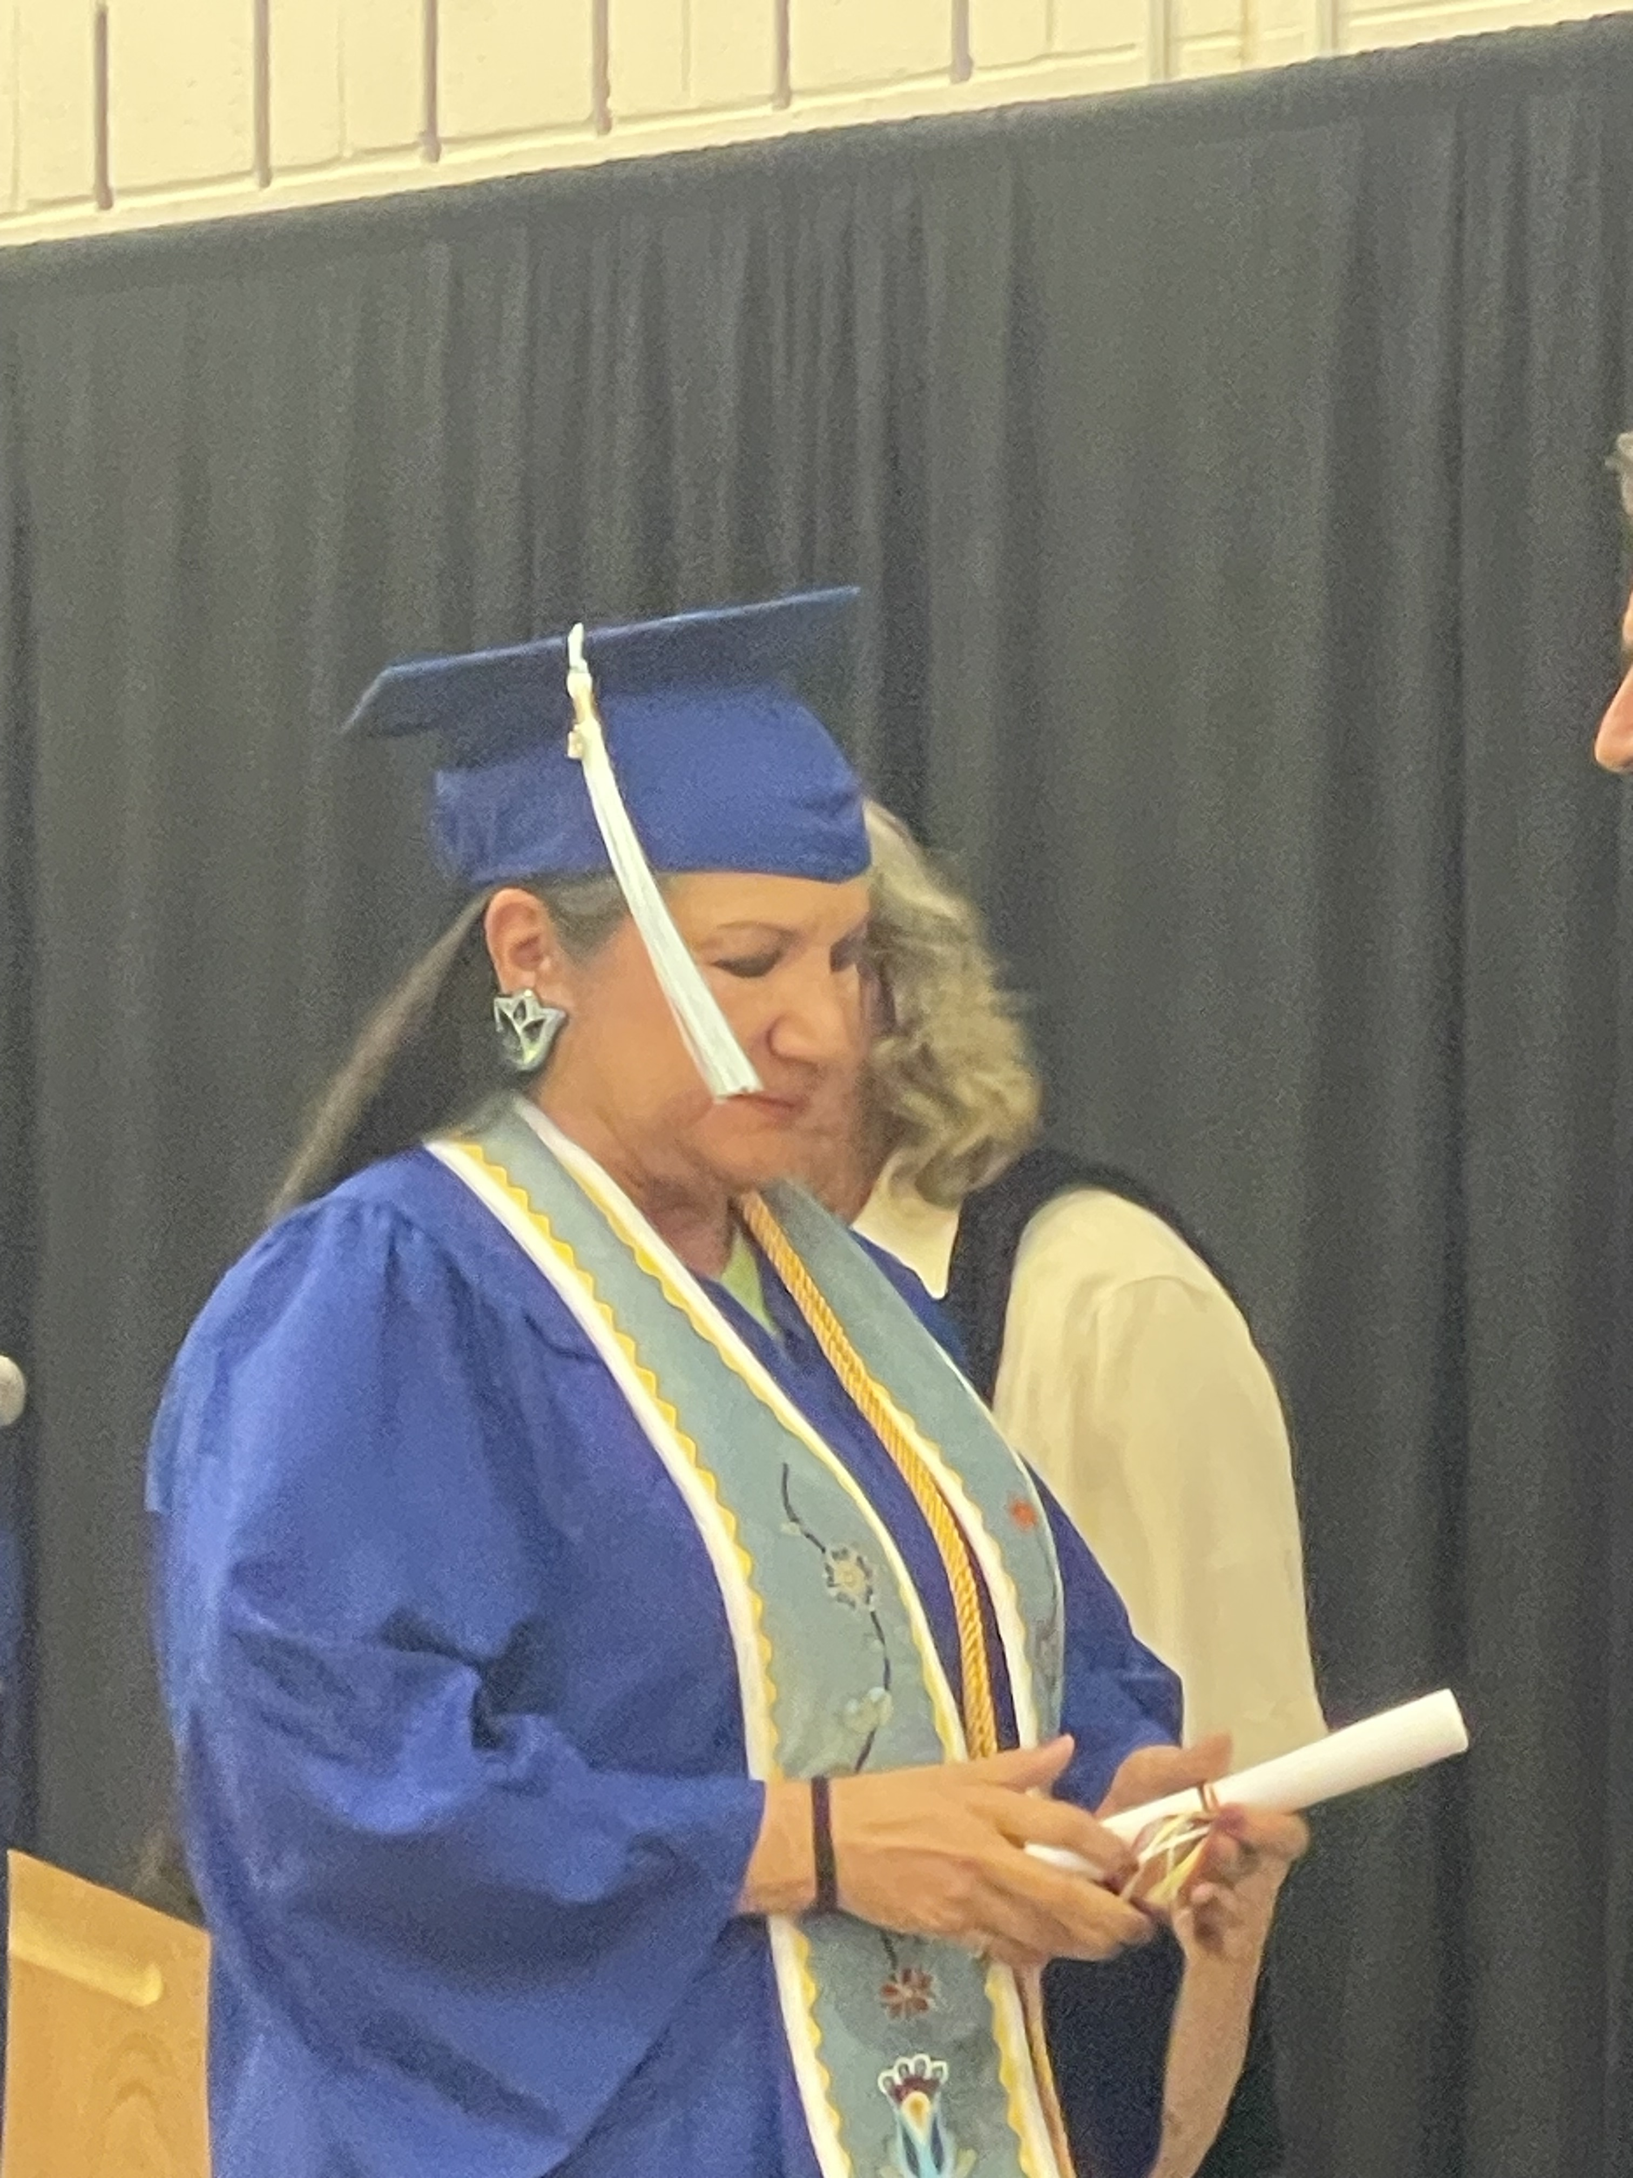
What is induction?
The induction ceremony is a pivotal moment in your teacher education program. It is significant because it is the acceptance into the Elementary Education program and recognition of your growth as a student preparing to be a professional leader in the education system.

Slide 7
Elementary Education
Vision
The vision of the FDLTCCC Elementary Education program is to be transformational leaders in culturally responsive pedagogy and Indigenous knowledge by embracing Niindaa’iwedaa o’o gikendaasowin, which means sending knowledge into the future by embedding Anishinaabe knowledge, culture, and traditions into the curriculum and instilling these teaching practices in our future educators.
Mission
The mission of the FDLTCC Elementary Education program is to work within our communities to prepare caring, competent educators by promoting equitable, inclusive, and transformative educational practices that are based on Anishinaabe knowledge, traditions, and culture.

Slide 8
Program Requirements
Elementary Education Program Application Process
GPA of 3.0 for all EDU prefixed courses
GPA of 2.0 for General Education courses
Dispositions that are aligned to the Cultural Standards
Mandatory attendance at Teacher Candidate Meetings – no exceptions!
Successful completion of Student Teaching

Slide 9
Dispositions
  Dispositions are the values, commitments, and professional ethics that influence behaviors toward students, families, colleagues, and communities, which affect student learning and achievement, motivation and development, as well as the educator's own professional growth.
  The Elementary Education program interweaves dispositions and guides our curriculum by aligning every course with the Seven Cultural Standards.

Slide 10
Seven Cultural Standards
GIKENDAASOWIN – Knowing Knowledge
GWAYAKWAADIZIWIN – Living a Balanced Way
ZOONGIDE’EWIN – Strong Hearted
AANGWAAMIZIWIN – Diligence and Caution
DEBWEWIN – Honesty and Integrity
ZAAGI’ IDIWIN – Loving and Caring
ZHAWENINDIWIN – Compassion

Slide 11
Dispositions
GIKENDAASOWIN
  Knowing Knowledge
  Disposition: Integrates Content and Pedagogical Knowledge
GWAYAKWAADIZIWIN
  Living a Balanced Way
  Disposition: Communication and Collaboration
ZOONGIDE’EWIN
  Strong Hearted
  Disposition: Vision and Leadership
AANGWAAMIZIWIN
  Diligence and Caution
  Disposition: Ethical Behavior
DEBWEWIN
  Honesty and Integrity
  Disposition: Data-Informed Practice
ZAAGI’ IDIWIN
  Loving and Caring
  Disposition: Equity, Social Justice, and Inclusion
ZHAWENINDIWIN
  Compassion
  Disposition: Life-long Learner

Slide 12
Transition to upper-level courses.
Why do we emphasize the Induction and what does this mean?

Slide 13
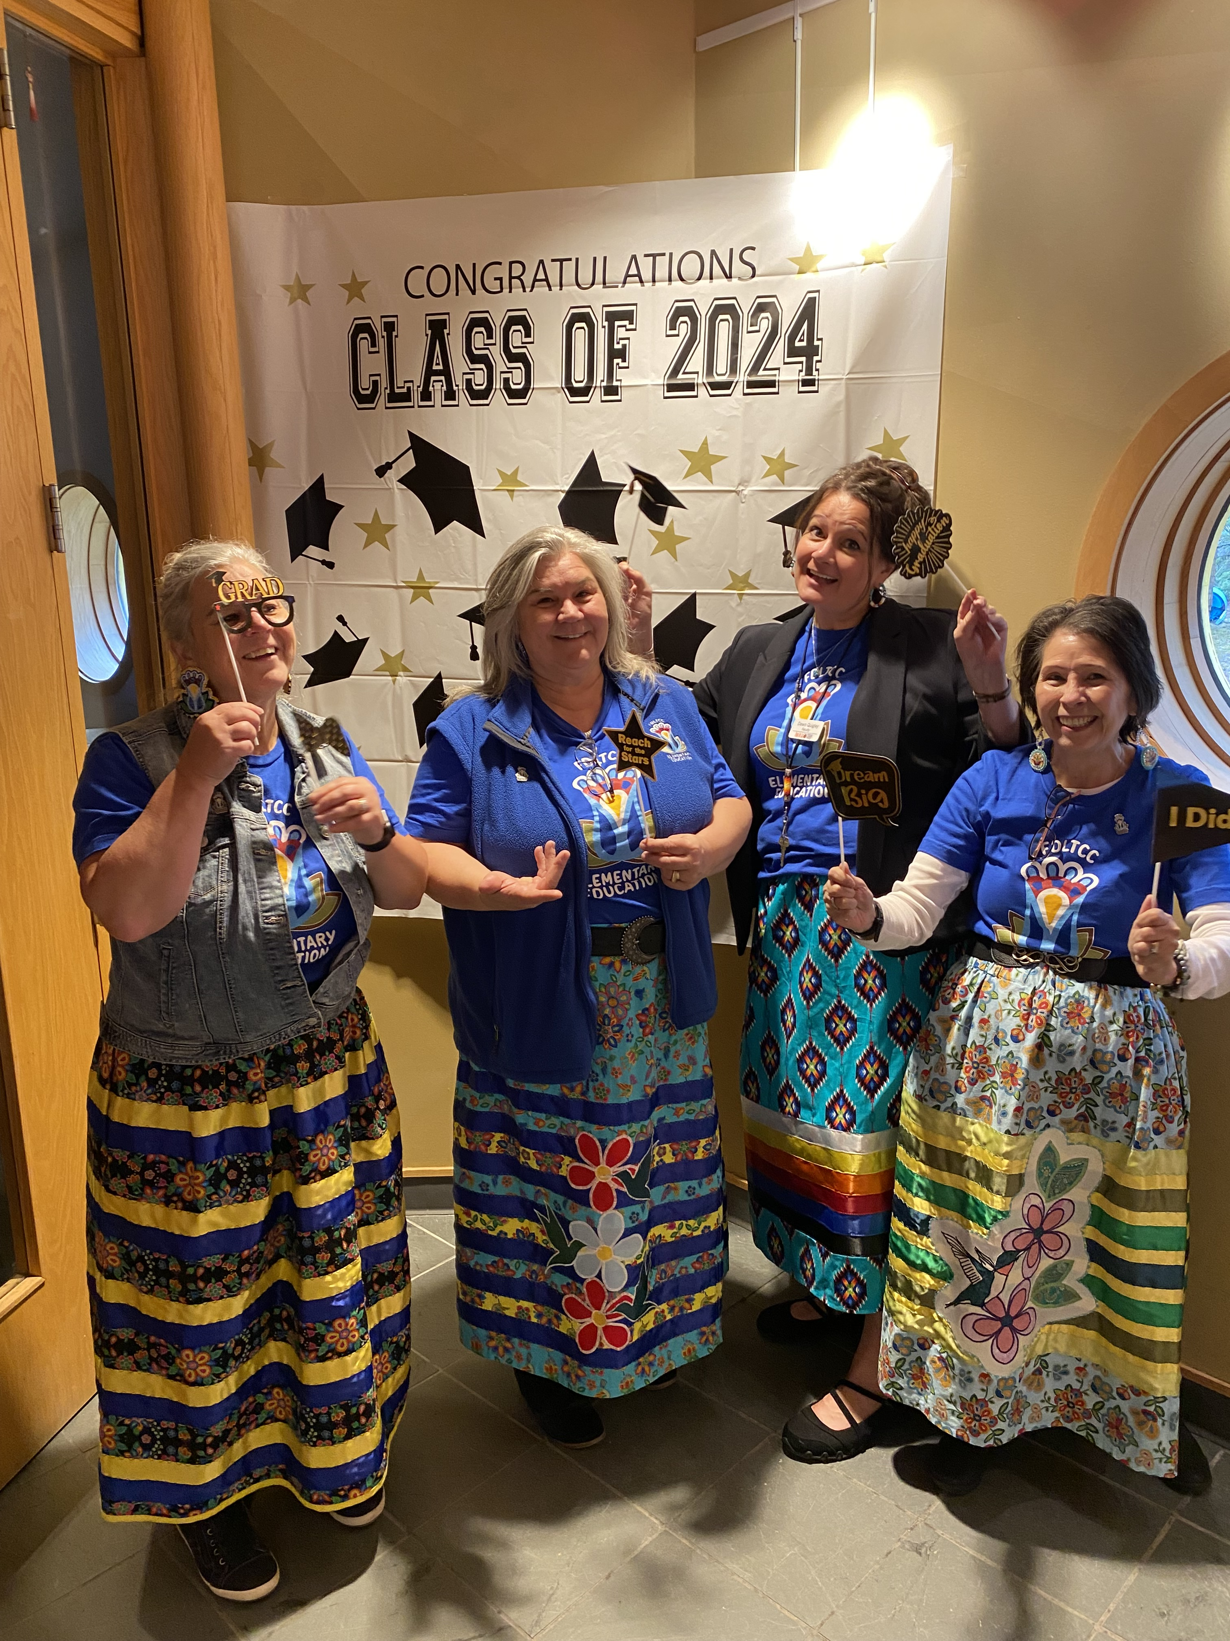
Before classes begin in the fall... it may seem like fun and games...

Slide 14
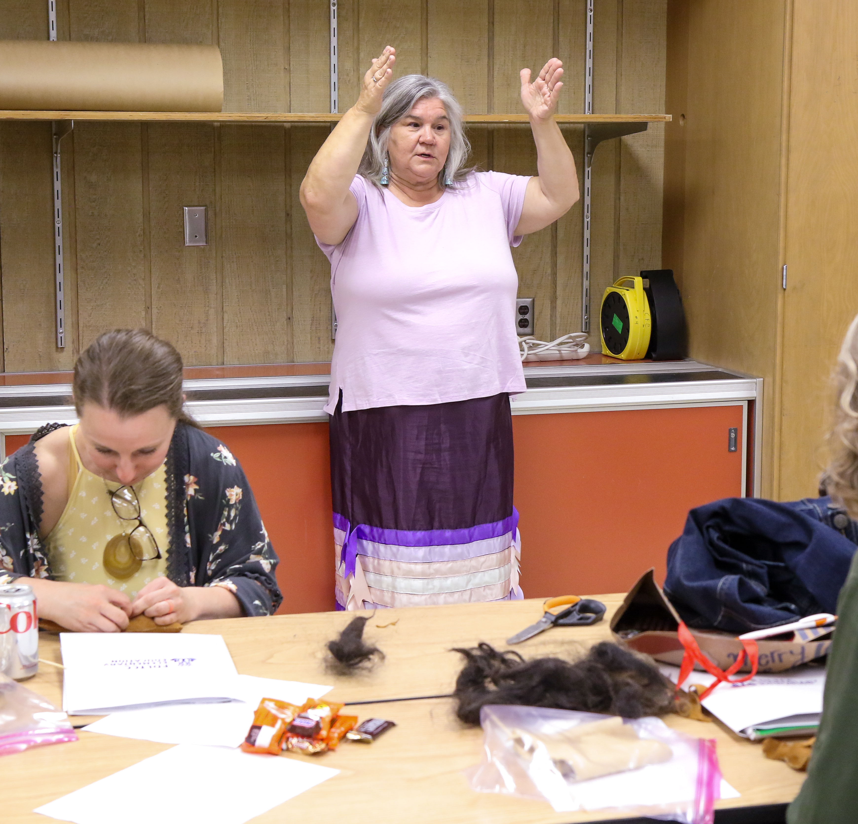
High Expectations for the Junior and Senior Year
Higher level of learning (which are higher expectations, "B" or better in all EDU courses).
Culturally Responsive Teaching practices
Preparing for field experiences:
  Dispositions are discussed with host teachers
  Dispositions are emphasized in every semester
Pedagogy refers to the methods and practices used in teaching.
  It includes lesson planning, classroom management, assessment, and how teachers interact with students.
Engaging in service and community practices within the communities we serve.

Slide 15

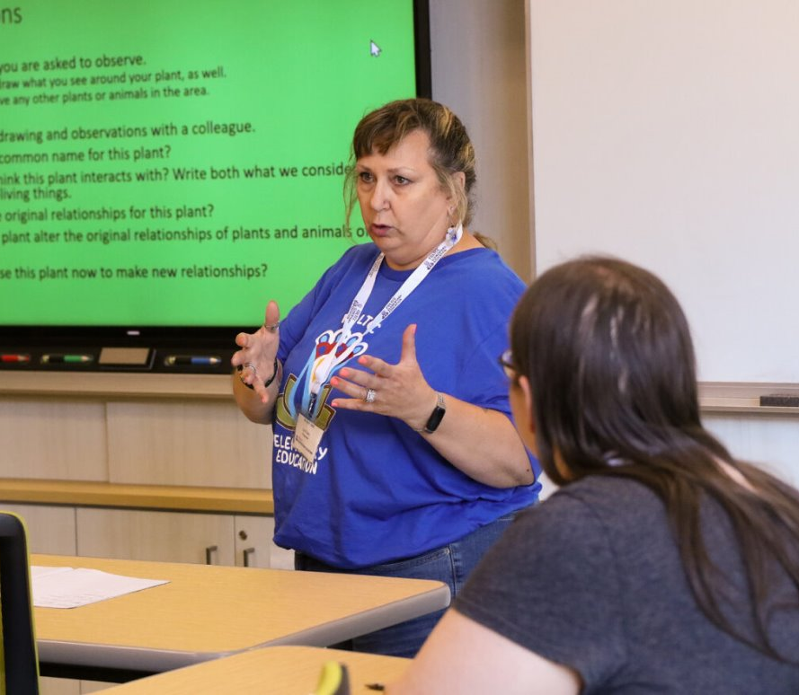
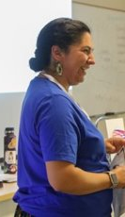
Higher level learning

Slide 16
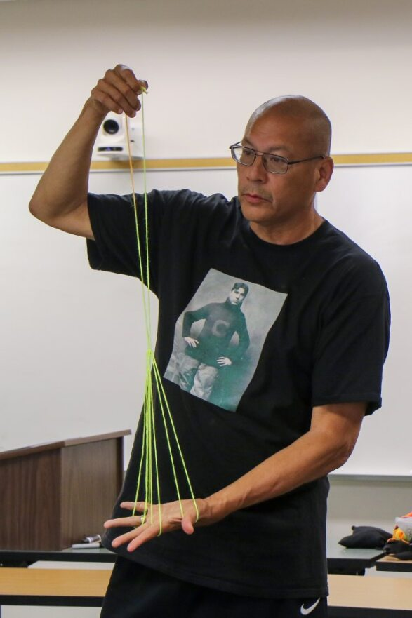
Learning how to intertwine cultural teachings into classroom practice while preparing for a MN License.

Slide 17
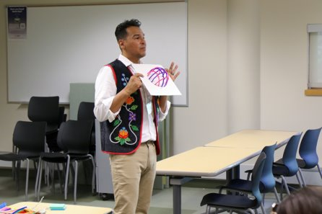
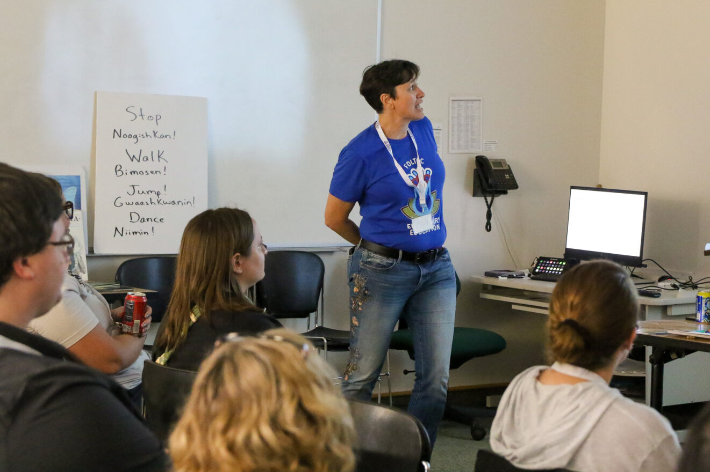
Pedagogy (Methods)
Practice

Slide 18

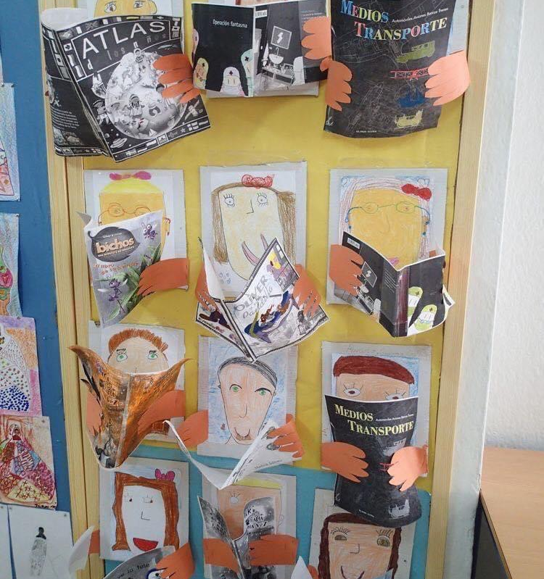
Pedagogy: lesson plans, classroom management,how to interact with one another.

Slide 19
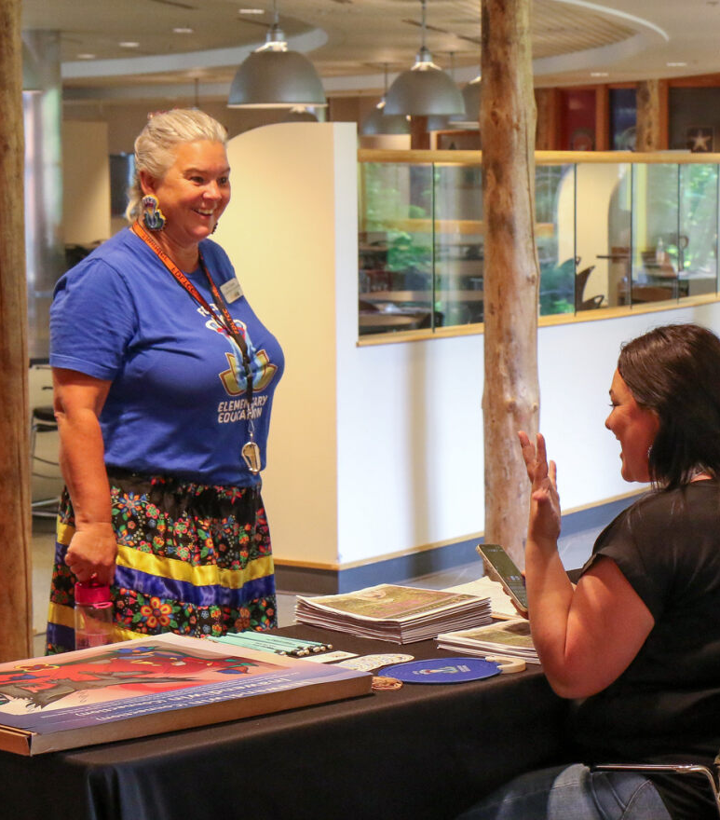
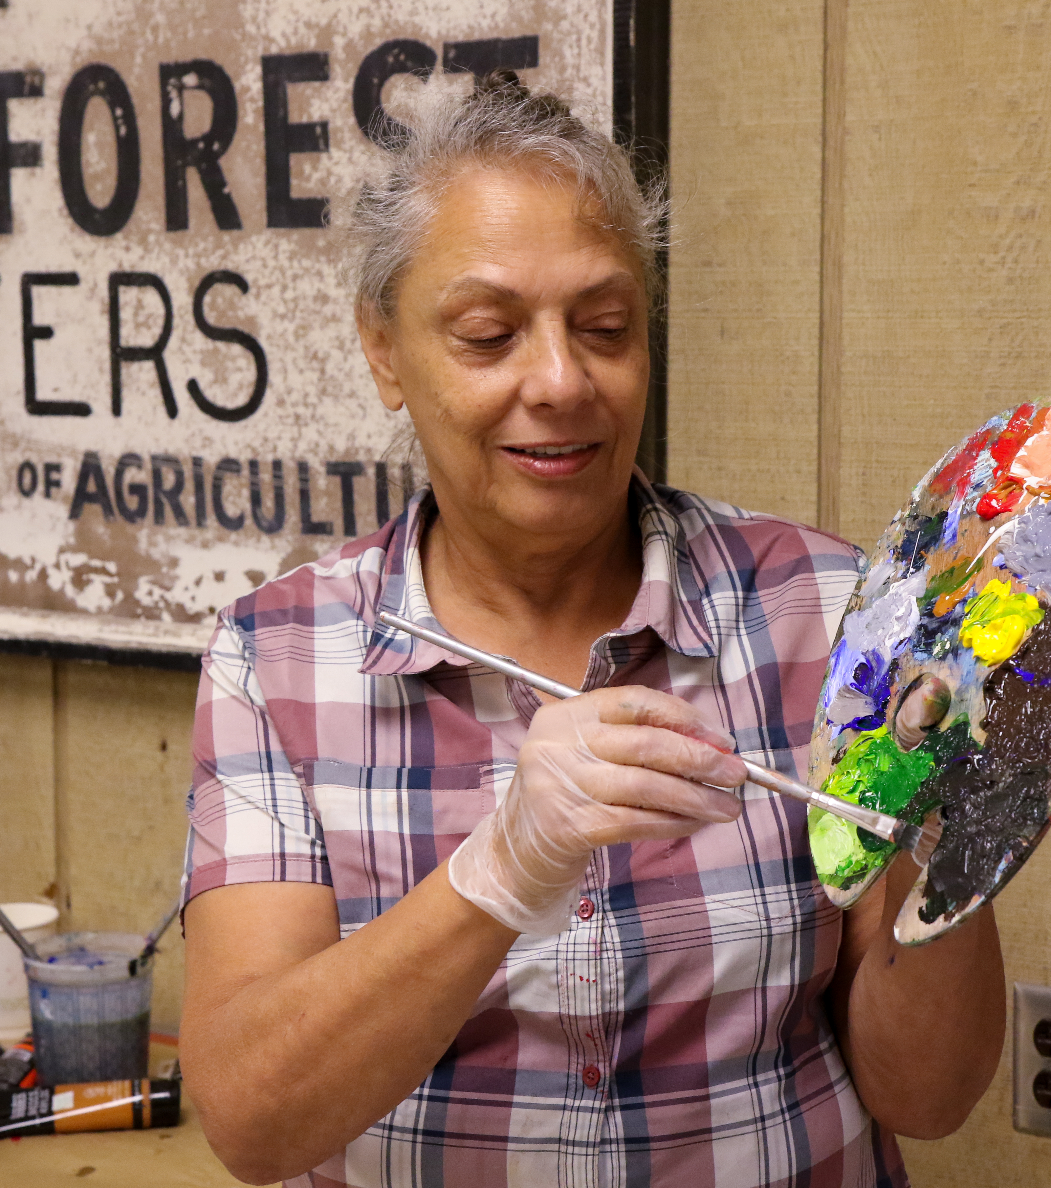
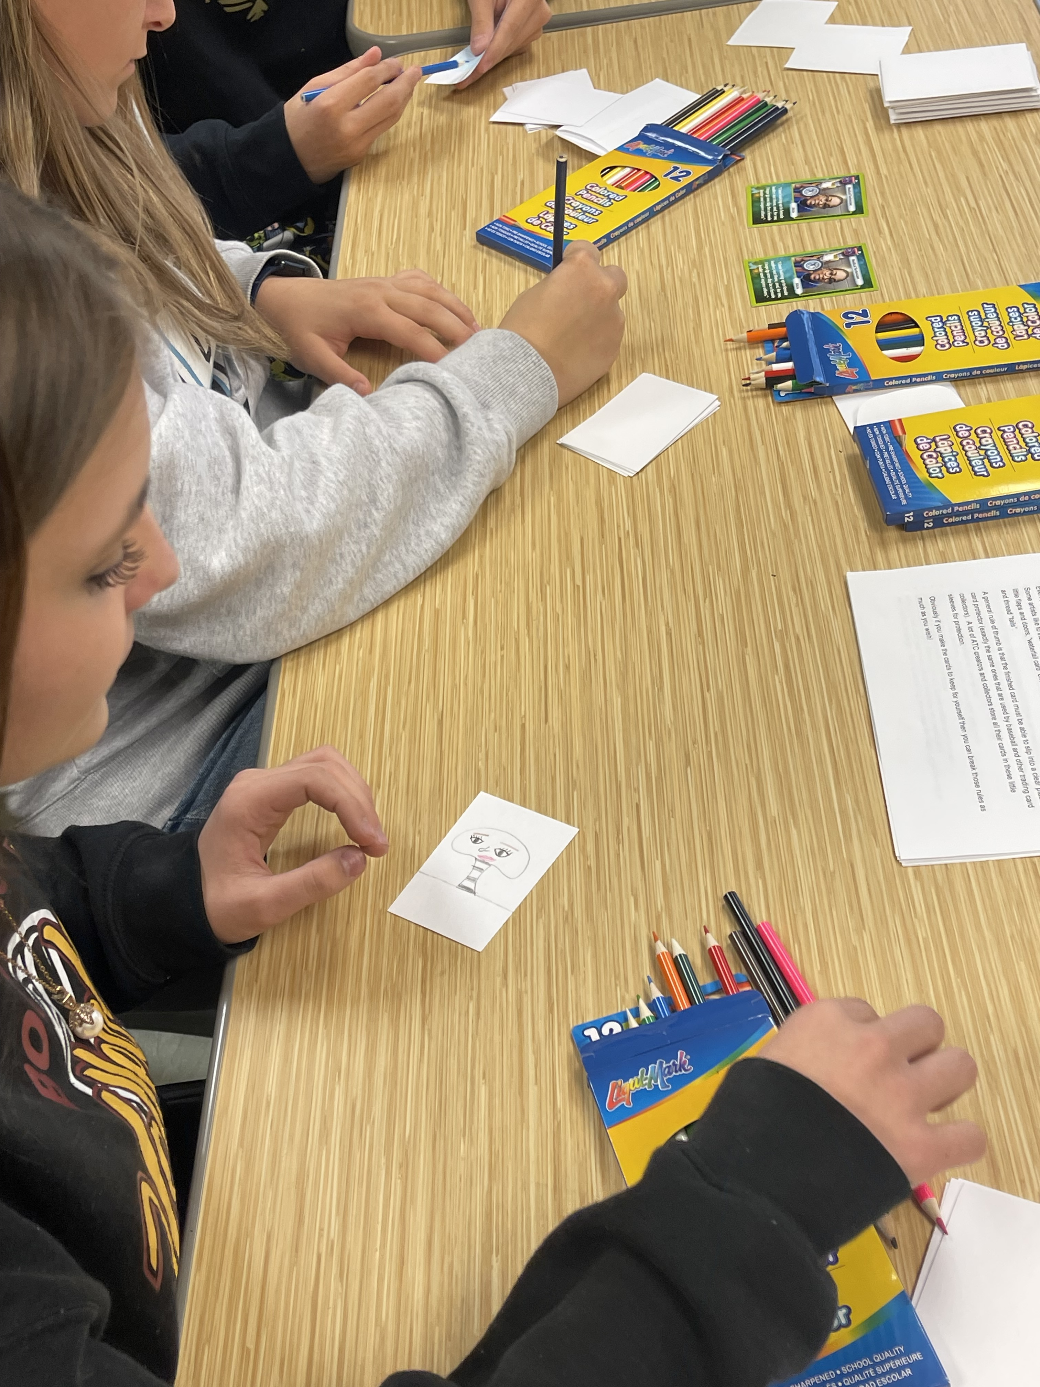
Engagement with the community.

Slide 20
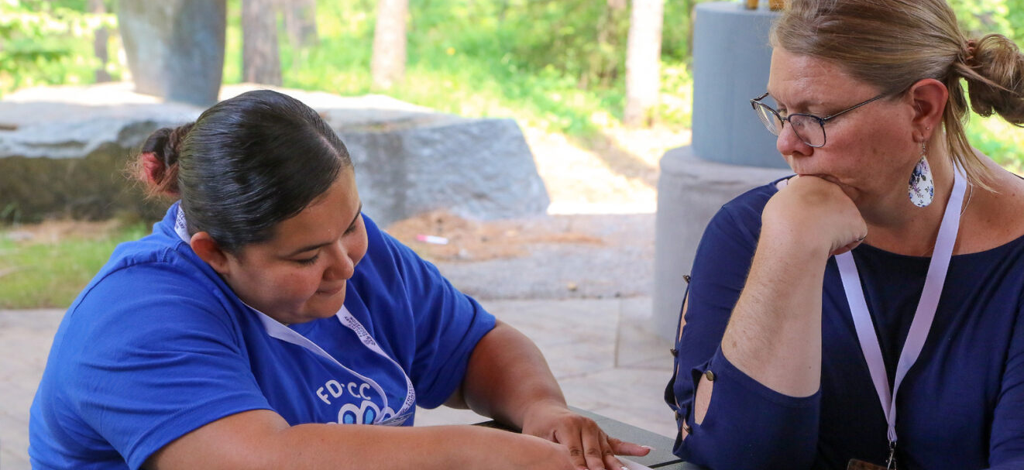
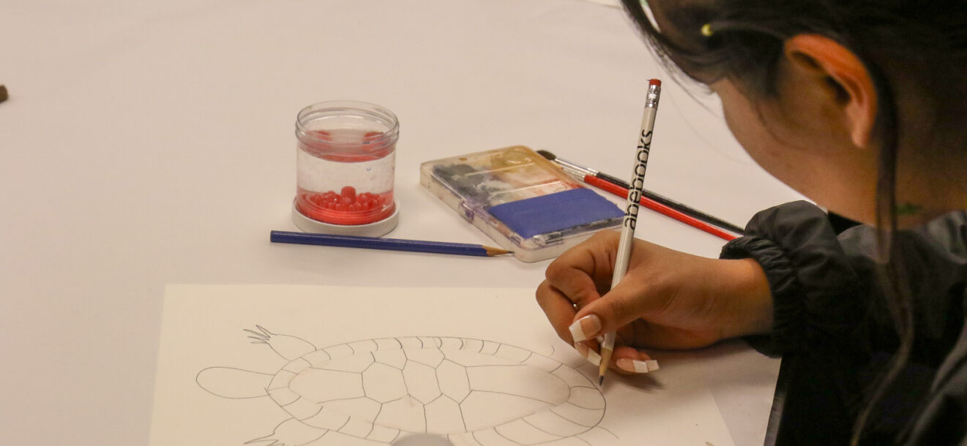
Student Teaching (CPAST)
Writing really good lesson plans
Videotaping field experiences
Many rubrics to respond to
3-4 observations & Tri-meetings

Slide 21
Intervention: Academic Success Plan
While it is hoped all candidates will meet and demonstrate all the dispositions, we realize that some teacher candidates might struggle with the dispositions that are needed for a K-6 classroom teacher.
If that occurs, an Academic Success Plan will be developed between the teacher candidate and the Elementary Education Program Coordinator or faculty advisor.
With careful faculty advising and the completion of the Academic Success Plan, the goal is that the candidates get back on track for successful program completion.

Slide 22
Field Experience, Insurance and background checks- Tara Graves
ALL placements will be set up by Tara Graves, Education Facilitator. Once placements are secured with the host teacher, you will be sent an email with host teachers contact information.
All Field Experience "logs" will now be completed in Watermark. Your host teacher will approve/not approve of hours/log category.
Insurance- Students must have proof of insurance (yearly) in order to begin ANY field Experience. If you are a MITTP recipient you can arrange time with Tara to come in a complete it online with her, if not the link is in Teacher Tool Box.. (D2L)
Background Checks- ALL students must have a Castle Branch background check prior to their field experience placements. If you are a MITTP recipient you can arrange time with Tara to come in a complete it online with her, If not the link is in Teacher Tool Box.. (D2L)
ALL Documents must be current, signed and on file (background checks, Insurance, Confidentality, Code of Ethics and Dispositions) PRIOR to any field experience starting.

Slide 23
More scholarship Opportunities
Paid Internships:
  3 available to El Ed students
  More than 10 hours of field experience
  You may be able to intern for up to 20 hours during the semester.
  Must apply to Jessica Thompson
Workforce Development
  3 available to El Ed students
  $1,200.00 a semester
  Must apply to Jessica thompson

Slide 24
Scholarships:
MITTP- Apply: students must email Tara Graves an for application.
FY: Students receiving MITTP funds, your monthly stipends may be impacted if the education team is notified of any issues with grades, attendance or disposition,
Student Teaching Grant: apply to the website listed.
This grant is provided only when students are completing their student teaching.
Application Website: Minnesota Student Teacher Grants (state.mn.us)
$7,500.00

