Slide 1

FDLTCC Elementary Education
Spring Orientation

Slide 2

Agenda/Topics to Be Covered
Welcome/Introductions
Mission and Vision
Student Handbooks
Planner
Expectations as Students & Teacher Candidate
Dispositions
Field Experience
Background Checks and Liability Insurance
Applying to the Elementary Education Program (Junior Status)
D2L/Teacher Toolbox; Watermark; Elementary Club/Special Events/Conferences; Scholarships
Questions, Concerns, feedback…

Slide 3


Who’s Who
Program Staff and Faculty/Adjunct
Students- Year In program

Slide 4
Vision and Mission
Vision ​The vision of the FDLTCCC Elementary Education program is to be transformational leaders in culturally responsive pedagogy and Indigenous knowledge by embracing Niindaa’iwedaa o’o gikendaasowin, which means sending knowledge into the future by embedding Anishinaabe knowledge, culture, and traditions into the curriculum and instilling these teaching practices in our future educators.
​
Mission ​The mission of the FDLTCC Elementary Education program is to work within our communities to prepare caring, competent educators by promoting equitable, inclusive, and transformative educational practices that are based on Anishinaabe knowledge, traditions, and culture. ​

Slide 5

HandBooks
FDLTCC HandBook –
FDLTCC Field Experience and Student Teaching Handbook
*These are available in the Teacher Tool Box in D2L

Slide 6
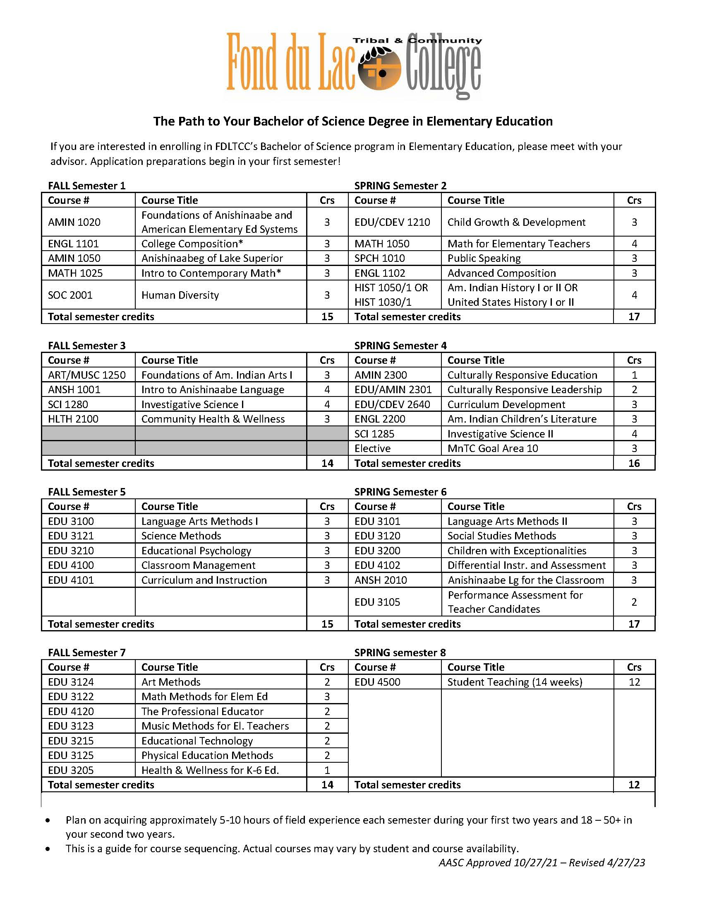
Bachelor of Science Degree Program Planner-

Slide 7
Student & Teacher Candidate Expectations, Confidentiality & Dispositions
Code of Ethics-
Confidentiality
Dispositions

Slide 8
FIELD EXPERIENCE
Follow your Field Experience Handbook
ALL Field Experience placements must be approved by Education Facilitator prior to your placement. Education Facilitator will arrange your placements!
Contact the Education Facilitator immediately if you have concerns about placement.
Students are responsible for purchasing their own background checks through Castle Branch and or the school district’s policy. Must provide proof to Education Facilitator.
Liability Insurance must be purchased and proven prior to ALL placements
Follow your instructors/class objective for each Field Experience. For example, it may be observation, interviewing, lesson plans, and assessment.
Students MUST log ALL Field Experience Hours in SL&L WaterMark
Students Must also have a current FDLTCC Student Identification Badge/Card, for entering school districts and schools.

Slide 9
Applying to the Elementary Education Program
Juniors- Must apply to Education Program: Email Tgraves@fdltcc.edu or Program Coordinator to request application (Microsoft Forms)
*Generally, this will take place spring of Sophomore year.

Slide 10
Other Information
Teacher Toolbox – D2L
Student Clubs
Scholarships
Student Volunteering and Community Involvement (parades, campus events, etc)

Slide 11
Miigwech~
Magwitch for choosing us!! You are the ones making a difference and creating history for FDLTCC!! Make us, your family, your future students and YOURSELF PROUD to be THUNDER!!☺
OFFICE- 241- Please stop in…
Good Luck… You got this!!

Slide 12
Questions, Concerns, Comments?

Slide 13
Header
Text

Slide 14
Header
Text

Slide 15
Header
Text

Slide 16
Header
Text

Slide 17
Header
Text

Slide 18
Header
Text

Slide 19
Header
Text

