Slide 1

FDLTCC Education Unit
Host Teacher Orientation

Slide 2

Boozhoo~ Welcome
Agenda
Introductions – Where are you teaching, and what grade, and are you a returning Host Teacher.
Orientation Delivery of PowerPoint
Questions

Slide 3
Bachelor of Science in Elementary Education Licensure Program
Conceptual Framework
Vision
The vision of the FDLTCC Education Unit is to be transformational leaders in culturally responsive pedagogy and Indigenous knowledge by embracing Niindaa’iwedaa o’o gikendaasowin, which means sending knowledge into the future by embedding Anishinaabeg knowledge, culture, and traditions into the curriculum and instilling these teaching practices in our future educators.
Mission
The mission of the FDLTCC Education Unit is to work within our communities to prepare caring, competent educators by promoting equitable, inclusive, and transformative educational practices that are based on Anishinaabeg knowledge, traditions, and culture.

Slide 4
Major Participants in Field Experience
Field Experience
Education Facilitator
Student~ Teacher Candidate
Host Teacher
Faculty/F.E Courses

Slide 5
Responsibilities of the Teacher Candidate(Professionalism)
Maintain student confidentiality at all times. Signed prior to F.E placement
Abide by the 8710.2100 CODE OF ETHICS FOR MINNESOTA TEACHERS.
Must have liability Insurance and approved by FDLTCC Facilitator on file at Education Office.
Background Check Must be approved and on File at FDLTCC Education Office.
Email Host Teacher once instructed by Education Facilitator who they are placed with to introduce themselves and thanking the host teacher for accepting into classroom! And arrange times that will work for both.
Provide Course Field Experience Expectations, and Dates and times when Teacher Candidate will be in classroom.
End of Field Experience Hours Teacher Candidates must have host teachers sign off on Field Experience Form with detailed explanation of activity/skill/description of time spend in classroom.

Slide 6
Responsibilities of the Teacher Candidates (Academics)
Complete course assignments and requirements
Attending Class and maintaining a 2.5 GPA
Communicating with Program Advisor, Education Facilitator if needs or issues arise.

Slide 7
Required Qualifications for Host Teachers
Positive recommendation by principal
Licensure on File, minimum of a tier 3
Certification in the subject area or grade level

Slide 8
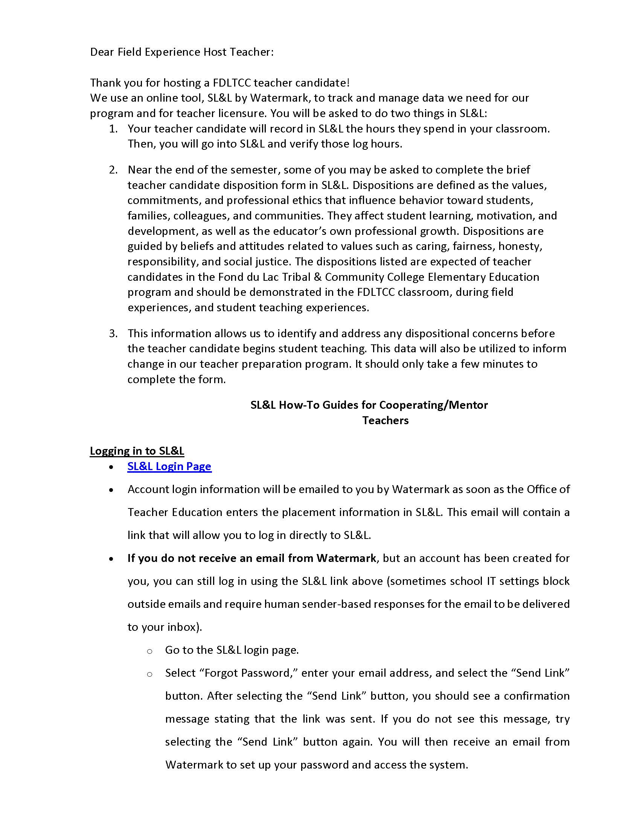
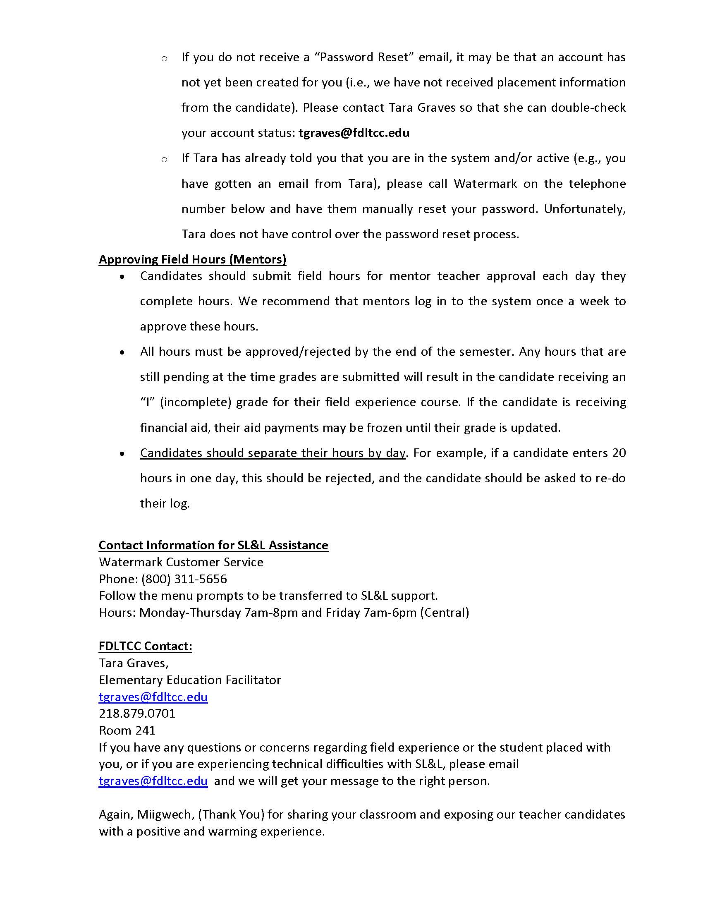
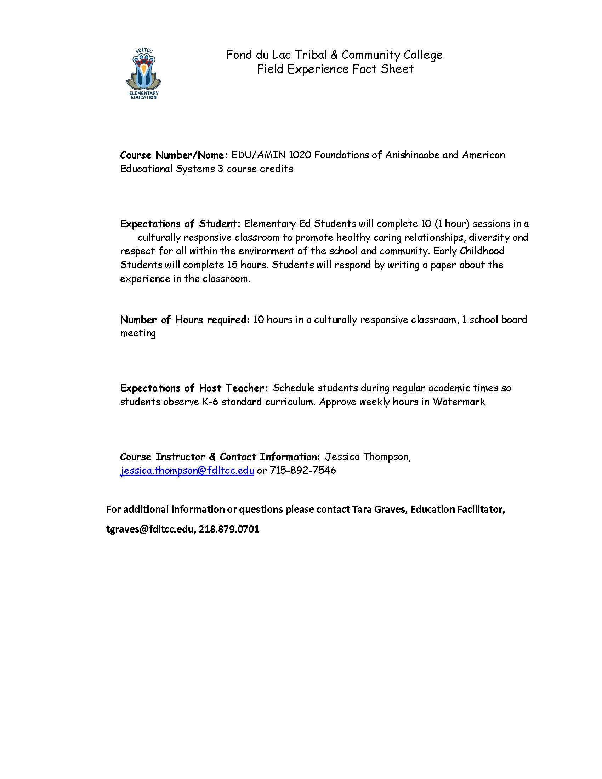
Responsibilities of the Host Teacher (Orientation)
Faculty Fact Sheet with Responsibilities/Expectations

Slide 9
Responsibilities of the Host Teacher (Providing Feedback)
Daily/Session oral feedback- Having a brief conversation with the Teacher Candidate regarding strengths and areas of improvement.
Sign into WaterMark, Student Learning, and Licensure, WaterMark, and approve (or not) students’ field experience log.
Communicate with the Education Facilitator- If concerns regarding the Teacher Candidate arise (attendance, appearance, work ethic etc.), to contact the Education Facilitator immediately to assist in the situation.
Final Evaluation- Completes a Summative Evaluation (in electronic form) of the Teacher Candidates’ effectiveness in each Disposition area. The Education Facilitator will send out the form after Field Experience hours are complete.

Slide 10
Important Safeguards
The teacher candidate must always be supervised by the appointed and approved host teachers.
A teacher candidate should never be left alone. If a teacher candidate is teaching a virtual sessions, the host teacher should be present in the session.
To be clear, teacher candidates should never assume sole responsibility for their students. If the host teacher is absent or unavailable the principal should appoint a licensed supervising teacher.

Slide 11
Responsibilities of the Education Facilitator (Advocacy)
Making contact with building principal to find a host teacher
Once the “referral” is reviewed, the Education Facilitator will then reach out to the host teacher regarding teacher candidate and the description of field experience goals for the selected course.
Create an email/Zoom session to introduce the teacher candidate and host teacher
Send out end-of-semester evaluation/dispositions on students.

Slide 12



Responsibilities of the Education Facilitator (Advocacy)
Set up an email or Zoom session to meet teacher candidates/host teacher prior to starting field experience hours.
Build rapport with teacher candidate and host teacher.
Communicate any issues or concerns with the EDU Faculty/Course Instructor

Slide 13
Responsibilities of the Faculty /Instructor (Evaluations)
Provide an Introduction letter to host teacher regarding expectations and outcomes for Teacher Candidate.
Communicate to the Education Facilitator of any issues regarding teacher candidates' academics/attendance, etc.
Verify teacher candidates field experience log for designated hours for course in WaterMark.
Conducting classroom Methods sessions.

Slide 14
WaterMark~ Student Learning & Licensure
Here is the link for Host Teachers to approve of student hours/logs.
Sign In | Watermark (watermarkinsights.com)
Please check periodically and verify hours. If students have not been showing up for “assigned times” please reach out to Field Experience Coordinator if you have concerns.

Slide 15
Dispositions/Evaluations
The purpose is to evaluate our students during their particpation in field experience.
This data will be utilized to improve student performance and to inform change in our field experience program.
A link to the disposition form will be sent to your email at the end of the semester.

Slide 16
Finally, what happens when the Faculty OR Host Teacher becomes worried about the student teacher’s progress?
The Host Teacher must call/email the Education Facilitator.
An Academic success Plan will be put in place immediately
If no improvement is made OR the principal calls the Education Facilitator, the student teacher will be removed from their site.

Slide 17
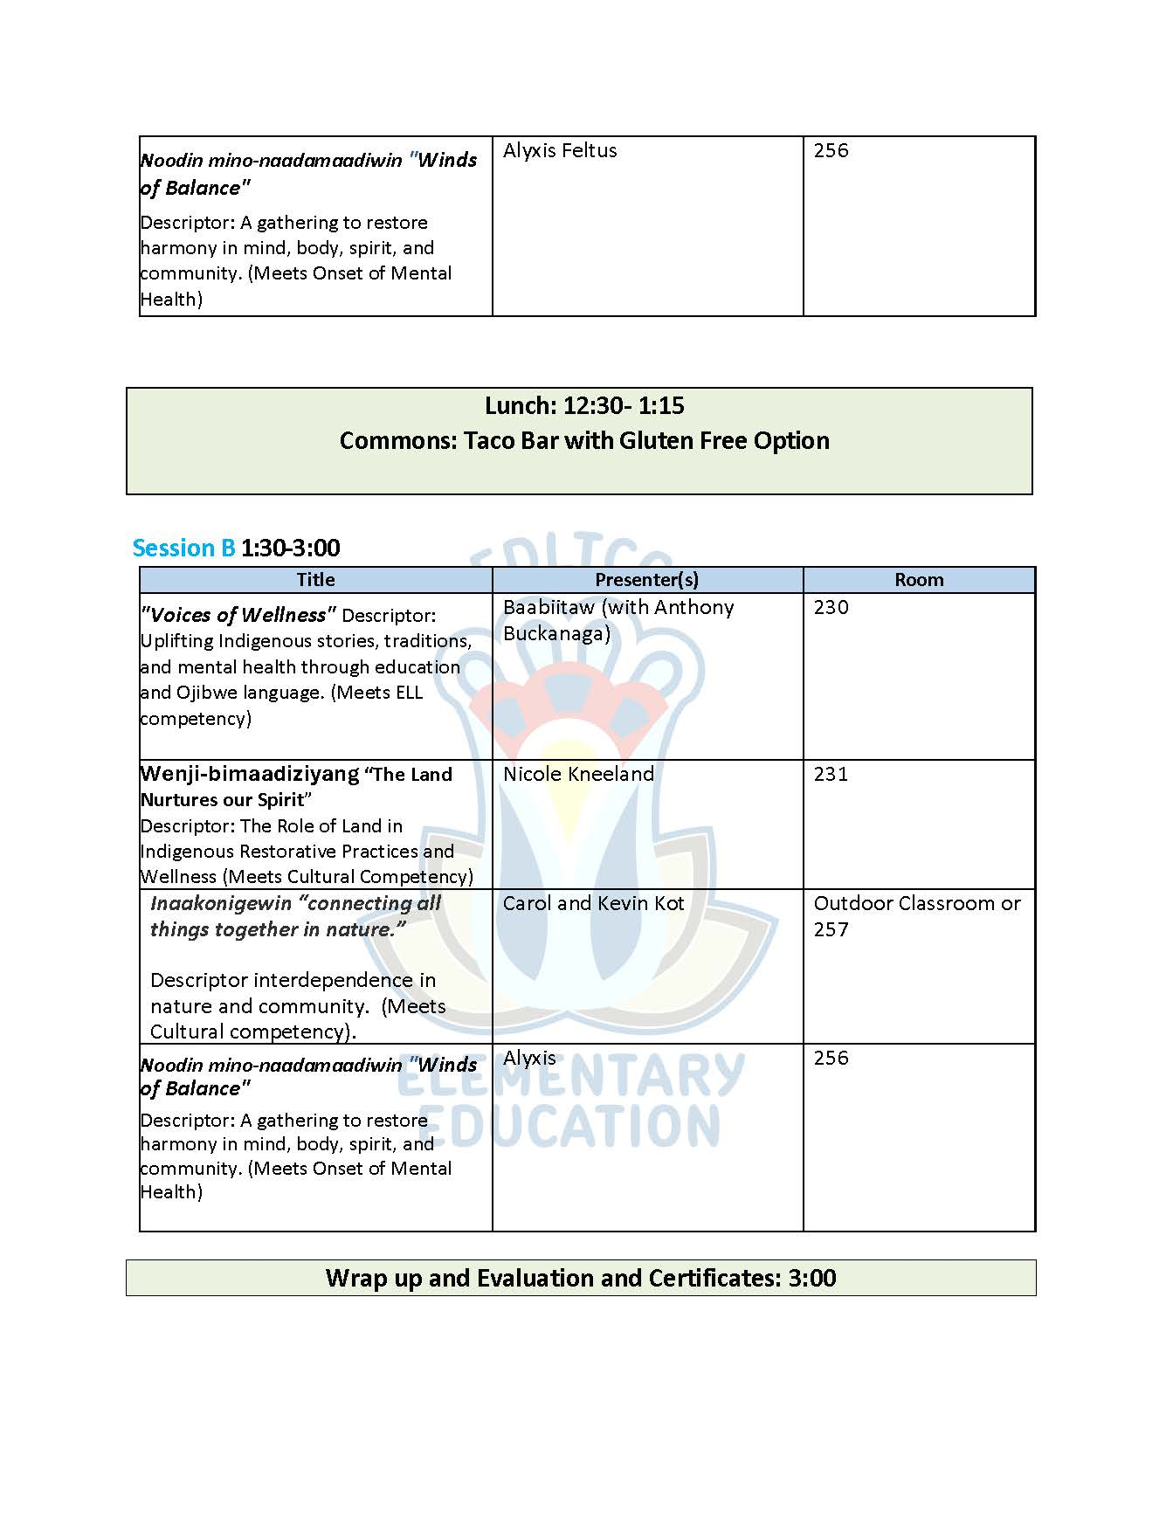


Our way of saying MIIGWECH!!
Host and Cooperating Teachers will be able to register for our ED FEST for FREE!! Great opportunity to get P.D for your CEU’s!

Slide 18
Questions??
Any further questions or concerns…
Tara Graves
FDLTCC Education Program Facilitator
218-879-0 701 | tgraves@fdltcc.edu

Slide 19
Miigwech
For your time, classroom, experience and providing the best to our future inspiring educators!!

