Slide 1

Elementary Education
Spring 2024
How do I Apply for My Teaching License?

Slide 2

Agenda
Introducations
Conceptual Framework
  Program Planner
  Faculty and Staff Bios
Statistics on American Indian Teachers
Curriculum
Enrollment
Student Teachers
Assessments
Ed Fest 2024

Slide 3


Important MTLE Update
Please note that the MTLE tests are no longer required!!

Slide 4

What License Do I apply for??
8710.3200 Elementary Education Grades K-6 Full

Slide 5
Tier 3
You have completed a licensure program, and
  You have earned your Bachelor’s Degree!
  Requires FDLTCC Elementary Education recommendation

Slide 6
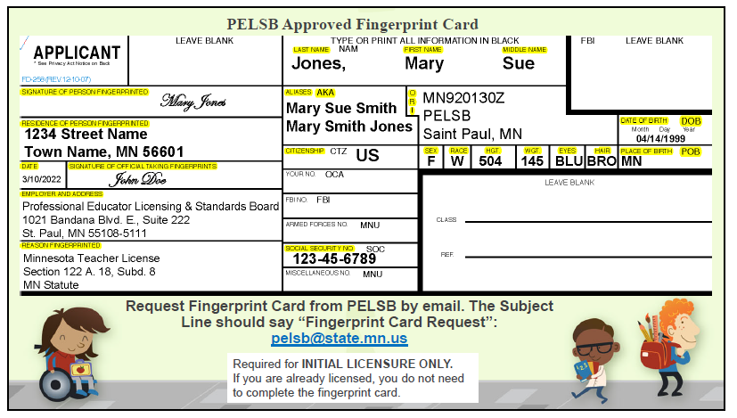
PELSB Approved Fingerprint Card

Slide 7
Fingerprint Card
Here are two things you can do now:
1. Contact PELSB and ask for a fingerprint card. You must use the PELSB fingerprint card. To request a fingerprint card, please email PELSB staff at pelsb@state.mn.us or call 651-539-4200 (option 1) and include your full name and current mailing address in your message. The subject line of the email should be “Fingerprint Card Request.” PELSB will mail a fingerprint to the address provided. We are unable to email fingerprint cards to candidates.
2. Schedule an appointment to be fingerprinted (i.e.: Local Law Enforcement). Appointments are usually required and there is a fee (approximately $20-25).
3. Do NOT complete this form prior to being fingerprinted. Some locations will enter your information into their computer and print it on the card.
4. DO use black ink when completing this form (if the fingerprinting location doesn’t fill it in for you).
5. DO make sure to fill out the form completely, including your signature and that of the official who took your fingerprints.
Tips from PELSB:
• Fill out the card with a black ink pen
• Provide your full name and include any aliases or previous names
• Enter PELSB’s ORI code: MN920130Z
• Enter your full date of birth, example 03/10/1999
• Citizenship = Country name (i.e.: US if you are a United States Citizen)
• When mailing your envelope to PELSB make sure to mark it “Do NOT Bend”.
• Good for 1 year from date of fingerprinting.

Slide 8
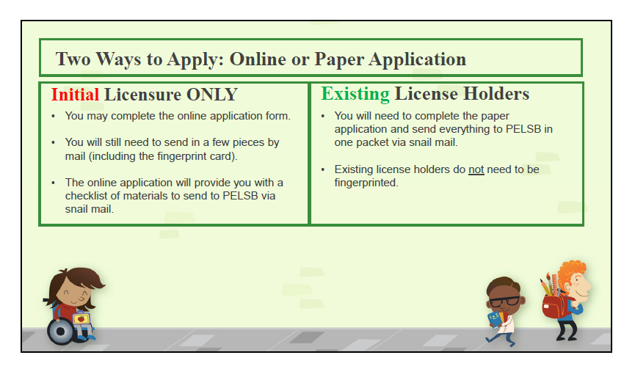
How to Apply

Slide 9
Initial License
All initial license applications can be submitted through the Online Licensing System.
Please note: If you have previously applied for licensure with our office and were assigned a file folder number and/or you are adding a licensure field, you are considered an existing license holder. Existing license holders cannot apply online. You must apply using a paper application which can be found using this link.
To verify if you previously applied for licensure with our office, please utilize the license lookup tool.
Within the applications, please note guides to identify which tier matches your qualifications and experiences. Please follow the instructions carefully to ensure that your application is complete, which is required for processing.
Under state statute, PELSB is required to issue or deny a license within 30 days after receiving a completed application, which includes all required application materials and a completed background check.
You will need to create a Google account if you do not already have one to submit an initial license application. Do not sign into the Online Licensing System if you currently hold a Minnesota educator license, a current or expired short-call substitute license, or a limited license and want to add a licensure field. Instead, complete the appropriate tiered license application found on mn.gov/pelsb/current-educators/additional-license/.
Log-in problems: To clear a CEL error message, you will need to delete your browser history, cache, and cookies. After clearing your browser, please log back into your online licensing account. Please Note: You will need to log in with the email address originally associated with your online licensing account. The system will not recognize an email account unless it was the email address you originally used.
Here is the link: Apply for a License / Professional Educator Licensing and Standards Board (PELSB) (mn.gov)

Slide 10
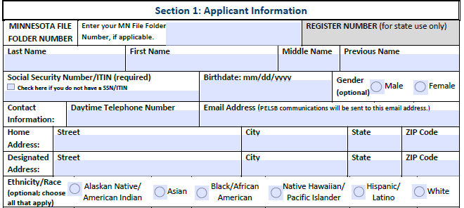
Application Section 1
Home Address: Your home address remains private if you enter a separate designated address. If there is no designated address, the home address does not remain private after the license is issued.
Designated Address: Your designated address may be a residence or place of business. Please note that the address you designate on this form does not remain private after a license is issued.
Ethnicity/Race: This section is optional and will not affect the decision of the application. You may choose more than one option.
Only if you have one

Slide 11
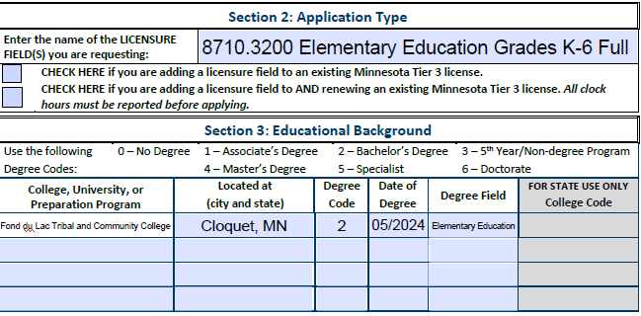
Application – Section 2 & 3

Slide 12
Header

Slide 13
Header
EDU/CDEV 1210 Child Growth and Development – 5 Hours in K-3 setting
ENGL 2200 American Indian Children's Literature – 5 Hours in a K-3 setting
MATH 1050 Math for El Ed Teachers – 5 Hours in a K-3 setting
EDU 3101 Language Arts Methods II – 15 Hours in a 4-6 setting
EDU 3200 Children with Exceptionalities – 15 Hours in a K-6 setting
EDU 4102 Differential Instruction & Assessment – 10 hours in a K-6 setting
EDU 3125 Phy Ed Methods – 8 Hours in a K-6 setting
EDU 4500 Student Teaching – 14 Weeks

